Slide 1

Movie Recommender System
- Rutvi Gohel
80% of what people watch comes from their recommendation system. As a result, recommender systems generate over $1 billion per year of Netflix’s revenue.

Slide 2
• What approach should I use to recommend movies, Content based or Collaborative based? • How to recommend movies when there are no user information? • What kind of movie features can be used for the recommender system? • How to calculate the similarity between two movies.
Problem Statement:
Goals :
The goals of this project is to generate meaningful movie recommendation to the user that they are really interested in.

Slide 3
Types of Recommender Systems
Content-Based
Movie Recommendation Systems
Collaborative Filtering
Movie Recommendation Systems
Recommend items that are similar with what user liked before.
Recommend items that similar user liked.

Slide 4
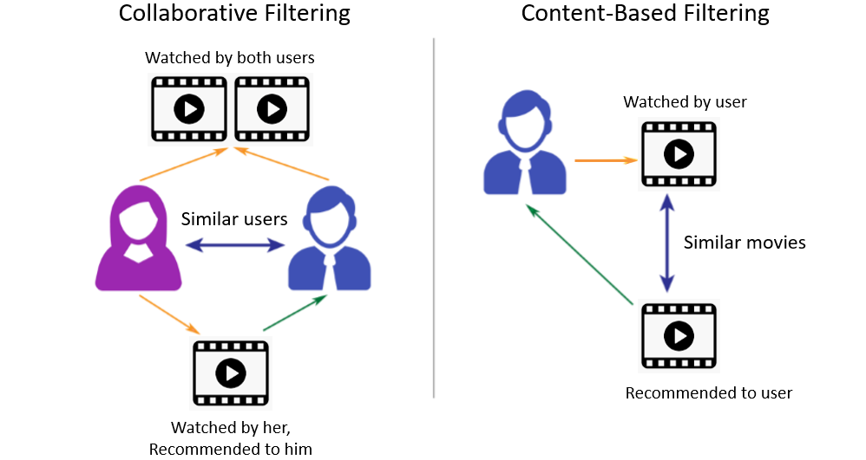
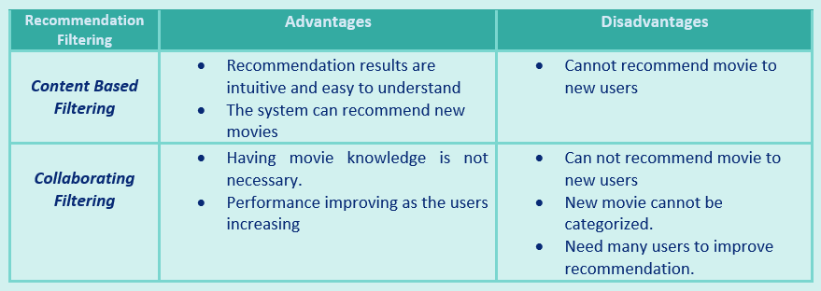

Slide 5
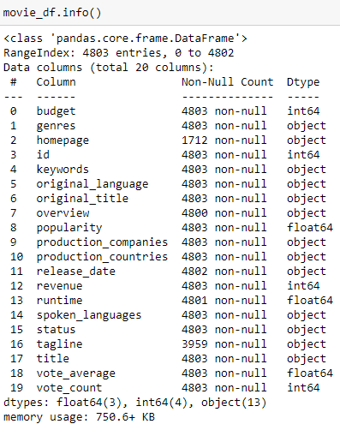
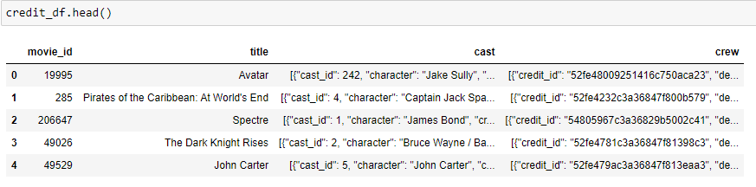
Dataset:
Kaggle Dataset
The Movie Database (TMDB) is a community built movie and TV database. This contains two datasets, named
credit_df = tmdb_5000_credits.csv
movie_df = tmdb_5000_movies.csv

Slide 6
Feature Extraction:
What encourages user’s decision in choosing a movie to watch?
Genres
Main Actors (Top 3 casts)
Directors
Overview
Tags = Genres + Top 3 casts + Directors + Overview + Keywords
Note, Tags = Documents

Slide 7
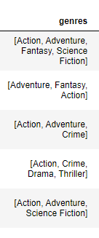
Pre- Processing
Pre-processing

Slide 8
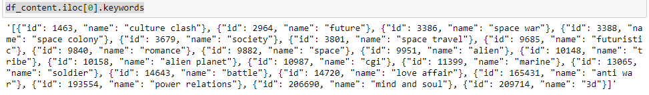
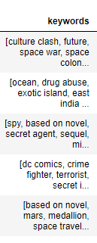
Pre- Processing
Pre-processing

Slide 9
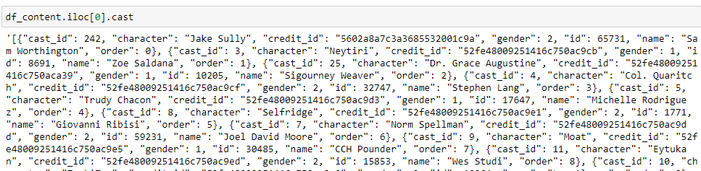
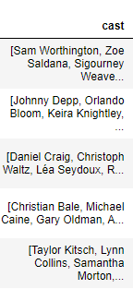
Pre- Processing
Pre-processing

Slide 10
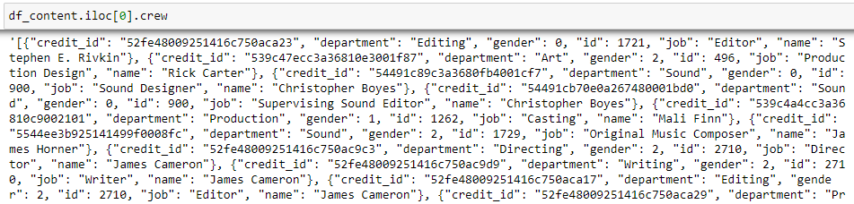
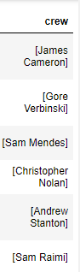
Pre- Processing
Pre-processing

Slide 11
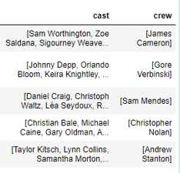
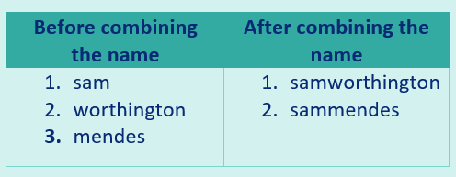
Are we ready to create tags?
Pre-processing

Slide 12
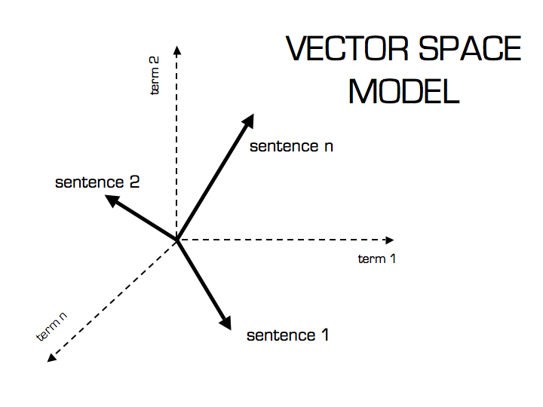
What’s next?
Transform Natural language (text and audio) into Numerical form.
TF – IDF
Stop words
Max Features
Lower case

Slide 13
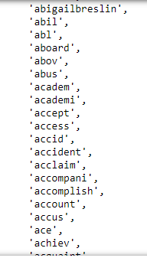
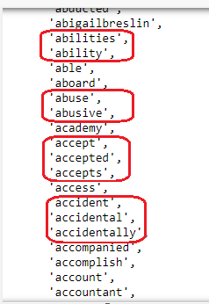
Stemming

Slide 14
How to predict/ recommend movie?
Cosine Distance
Directional Similarity
Distance
Euclidean Distance
Magnitude Similarity

Slide 15
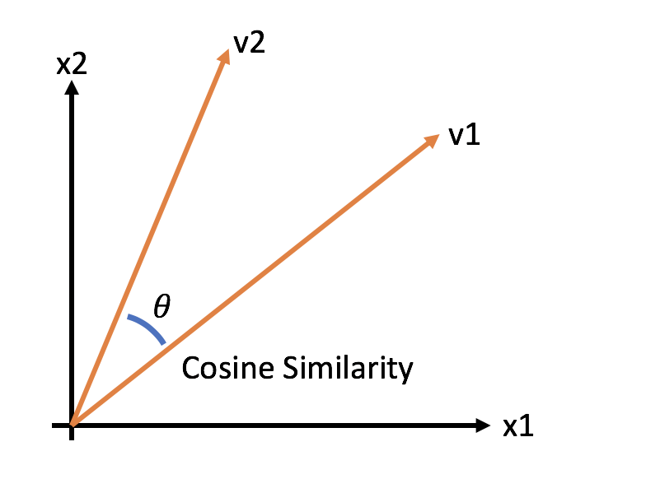
The cosine similarity between two vectors is measured in θ.
If θ = 0,
Movie A and Movie B overlap, thus proving they are similar.
If θ = 90,
Movie A and Movie B are dissimilar.
If θ = 180,
Movie A and Movie B are opposite.

Slide 16
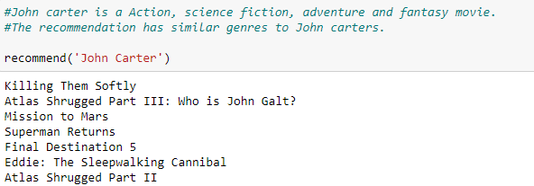
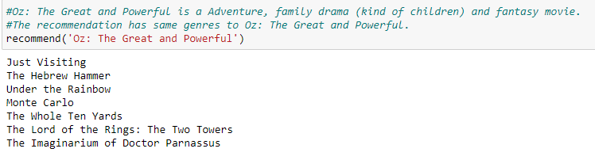
Result
Action
Science Fiction
Adventure
Fantasy
Adventure
Family Drama
Fantasy
Children Movie

Slide 17
Future Work
Use Hybrid Filtering Recommendation.
Introduce User Dislike movie list

Slide 18
Acknowledgement
I would like to Thank Mr. Daniel Wu for guiding me in this project.

Slide 19
Thank You!
Rutvimgohel@gmail.com
https://www.linkedin.com/in/rutvigohel-datascience/
https://github.com/PassionateDataScientist

